Slide 1
Lab 2
Scan Web Elements

Slide 2
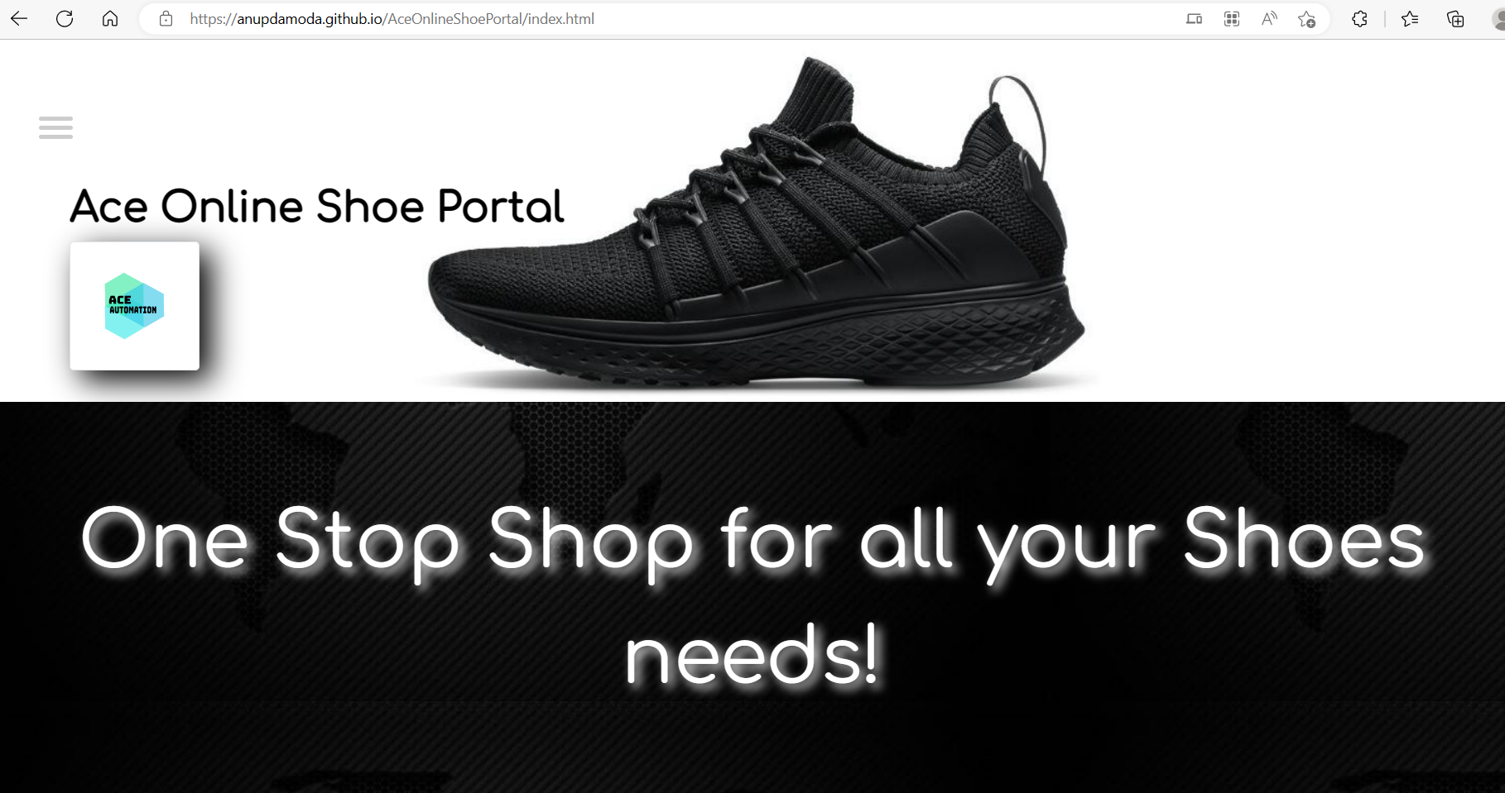
Application Under Test
Ace Online Shoe Portal (anupdamoda.github.io)

Slide 3
Web Elements
Scan the following web elements:
Text Boxes
Buttons
Radio Buttons
Web Tables
Dropdowns
Images
Links

Slide 4
Index Page
Check Box
Links

Slide 5
Scan the index page
Click on Scan Application in TOSCA. Select the AUT.
Advanced View - Select all the web elements on index page. Observe they are unique.
Click Finish Screen. Close.

Slide 6
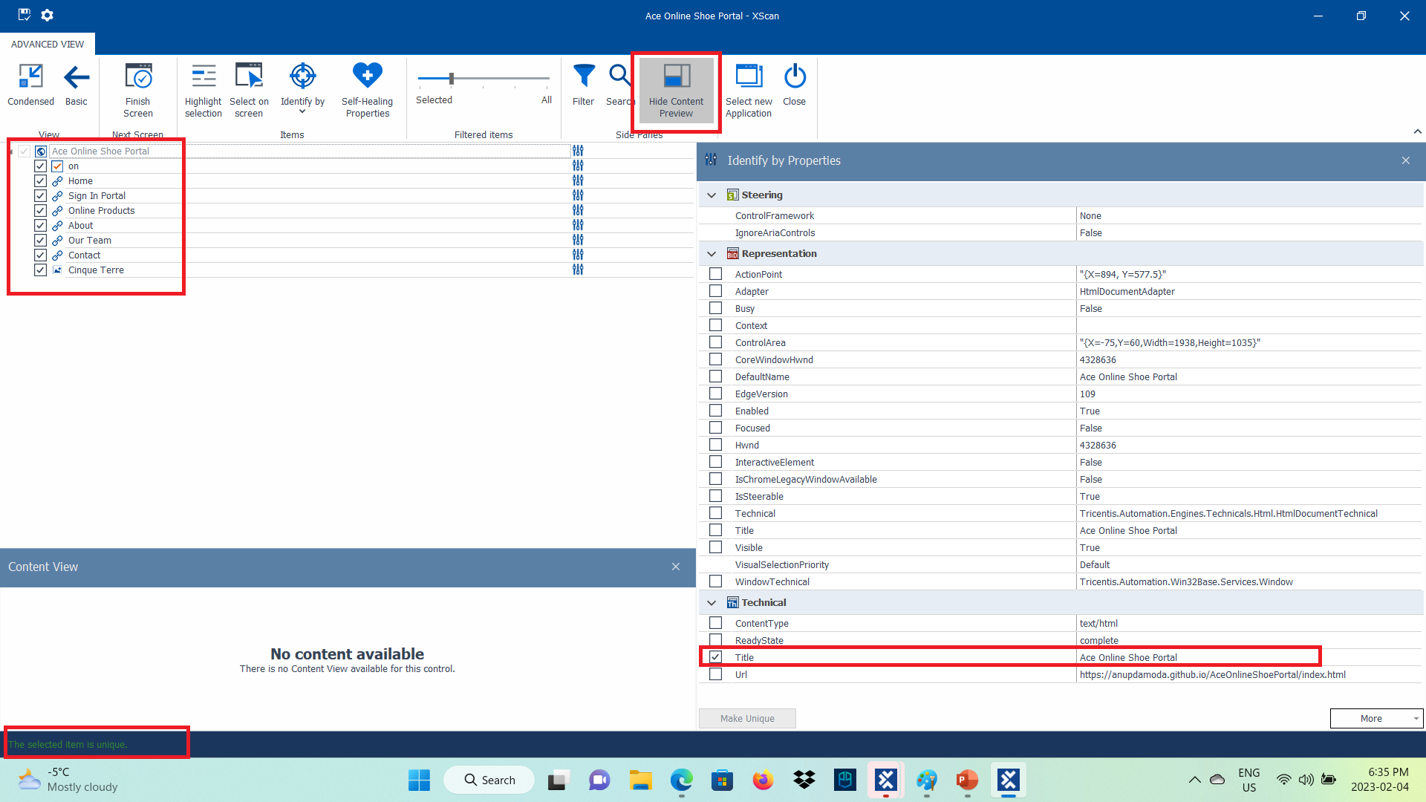
Scan the index page

Slide 7
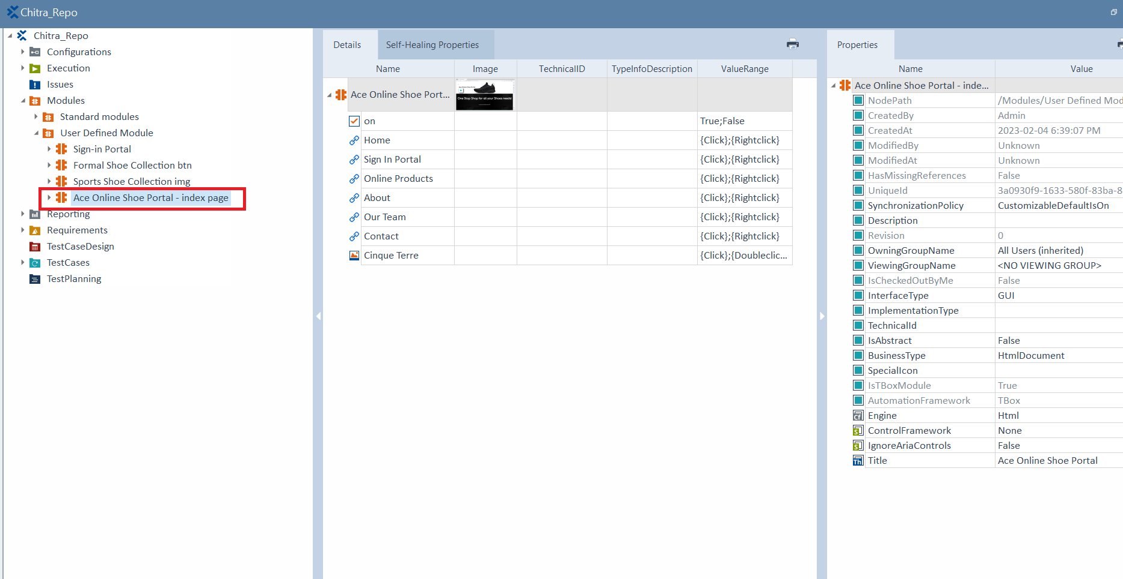
New Module is created
Rename the module

Slide 8
Sign In Portal
Text Boxes
Buttons
Links

Slide 9
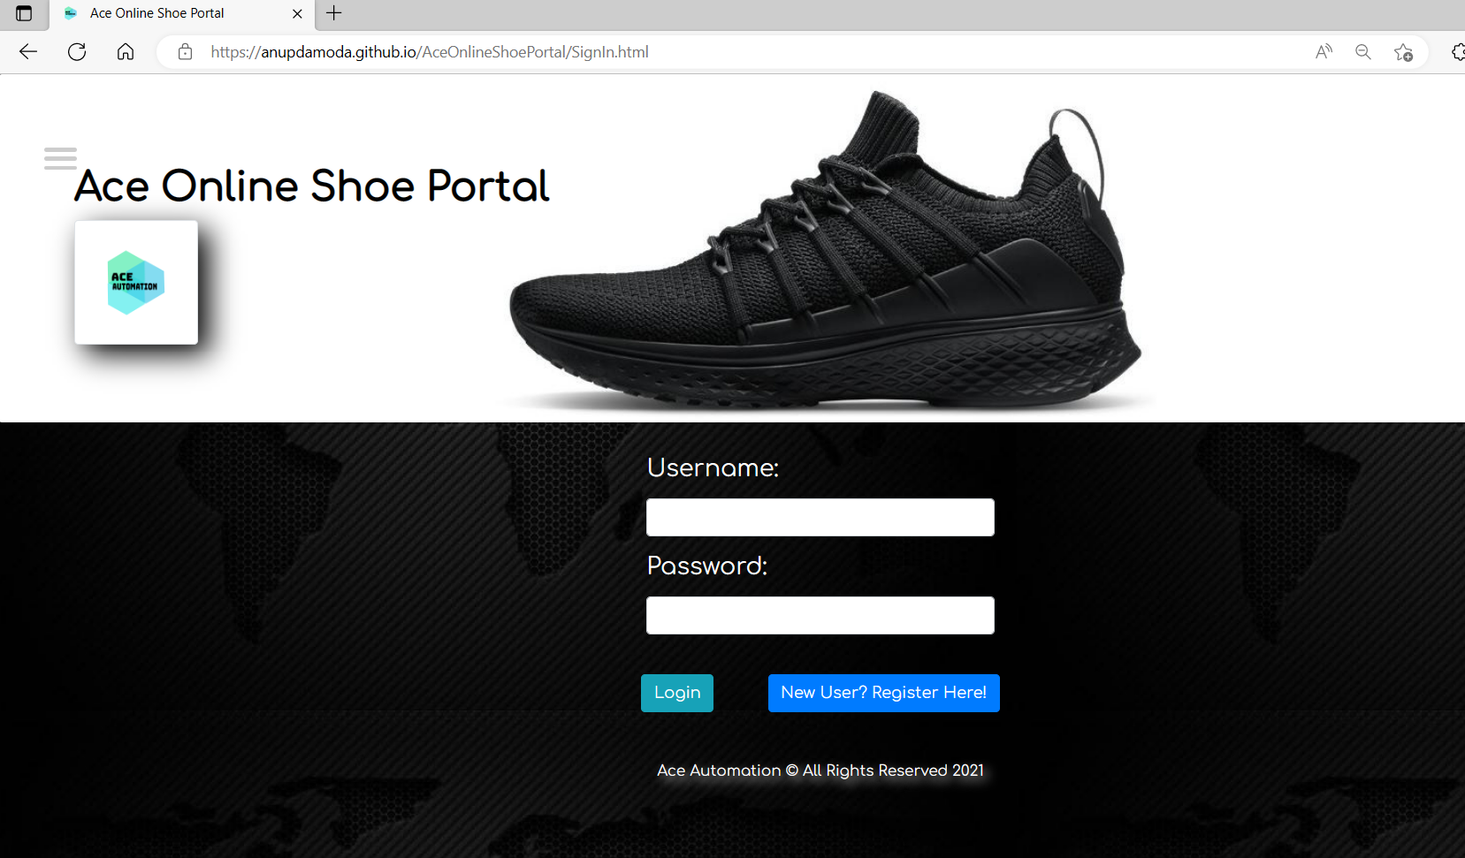
Sign in Portal Page

Slide 10
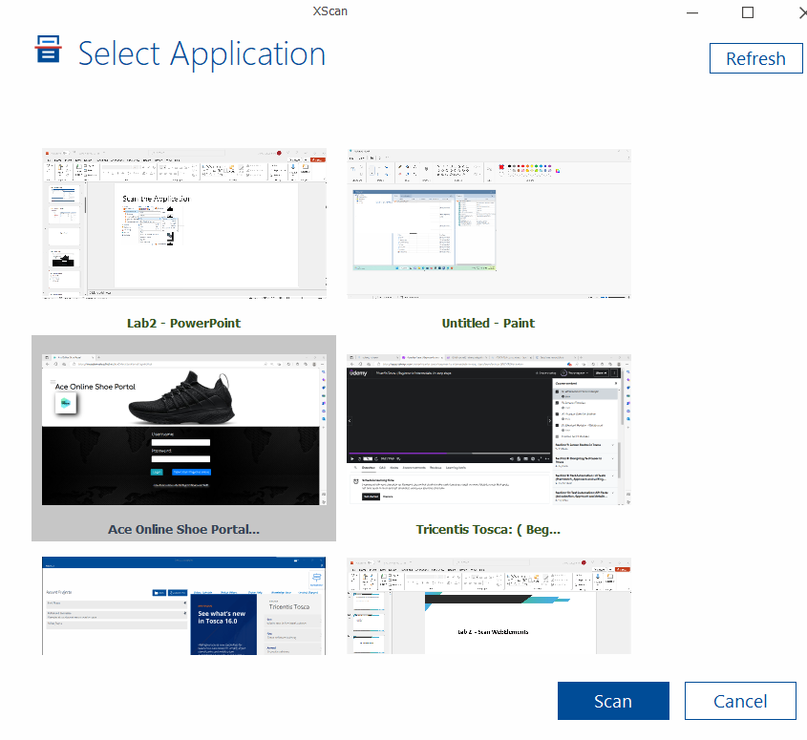
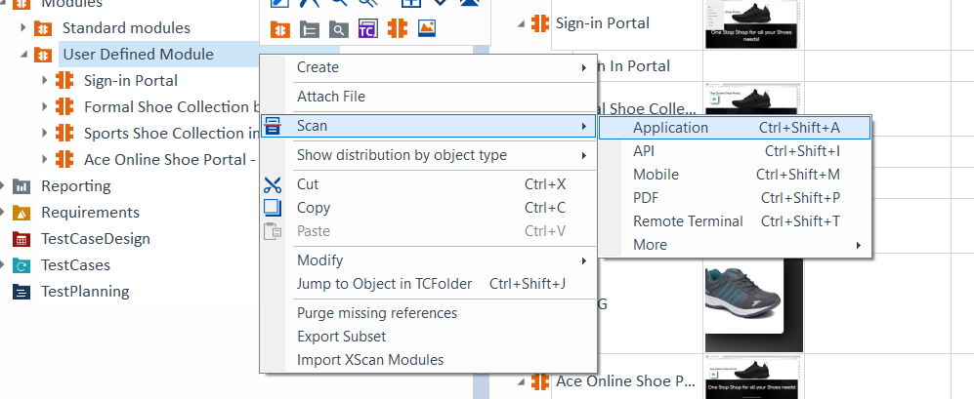
Scan the Application

Slide 11
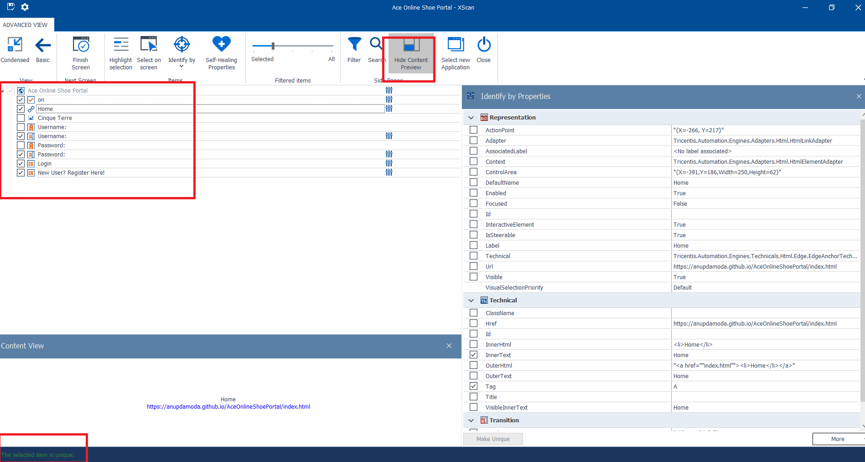
Advanced View - XScan the Application
Select the textboxes. Ensure all are unique items.
Finish Screen and close.

Slide 12
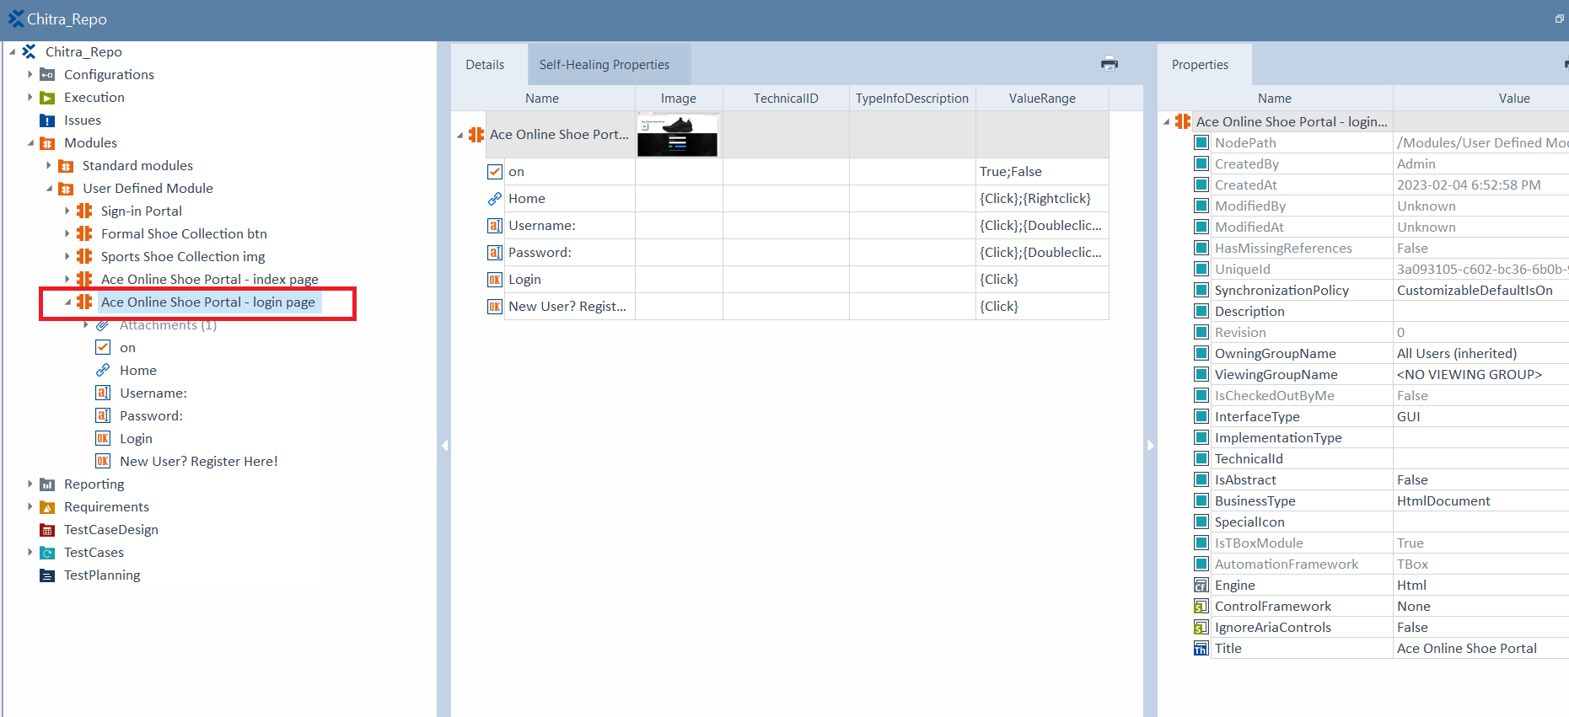
Verify and Rename the Module
Go to TOSCA Modules
Observe the new User Defined Module created.

Slide 13
Formal Shoes List
Radio Buttons
Web Tables
Dropdowns

Slide 14
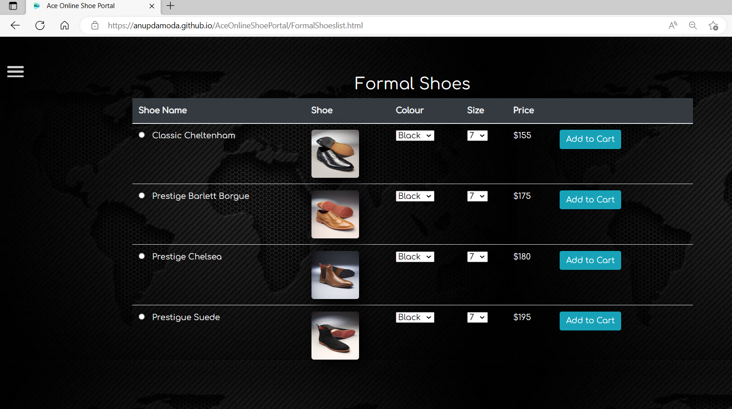
Formal Shoes List
Login to the application using tlisbon/tlisbon
Click on “Click on Exclusive Collection ” of Formal Shoes

Slide 15
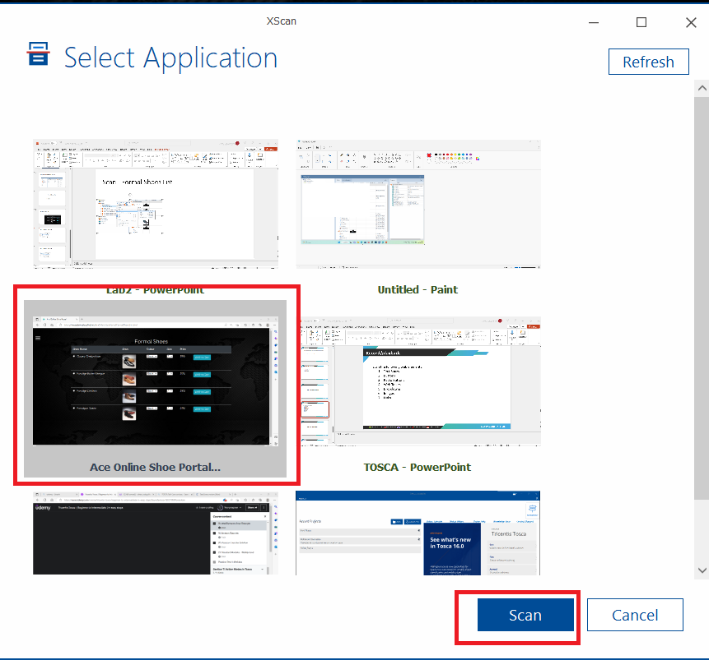
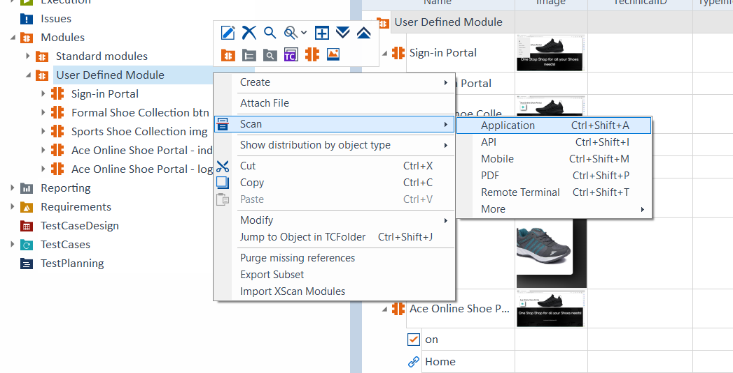
Scan - Formal Shoes List

Slide 16
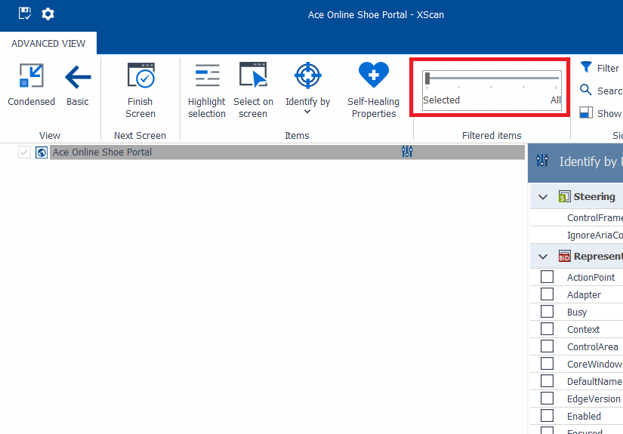
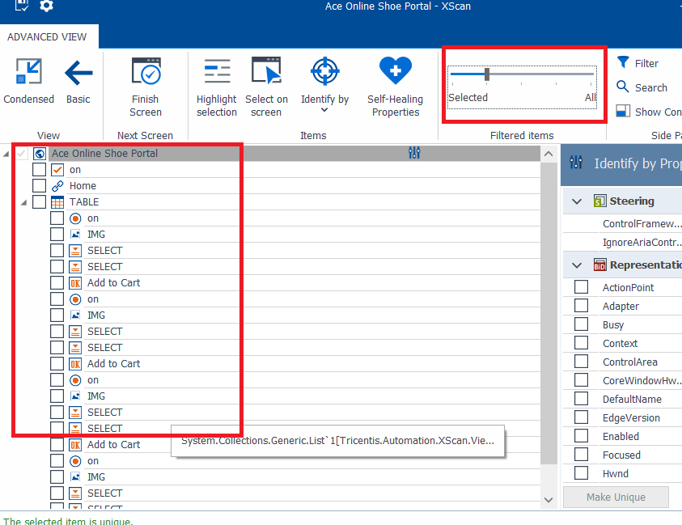
Advanced View Scan - Formal Shoes List
Make Selected to None

Slide 17
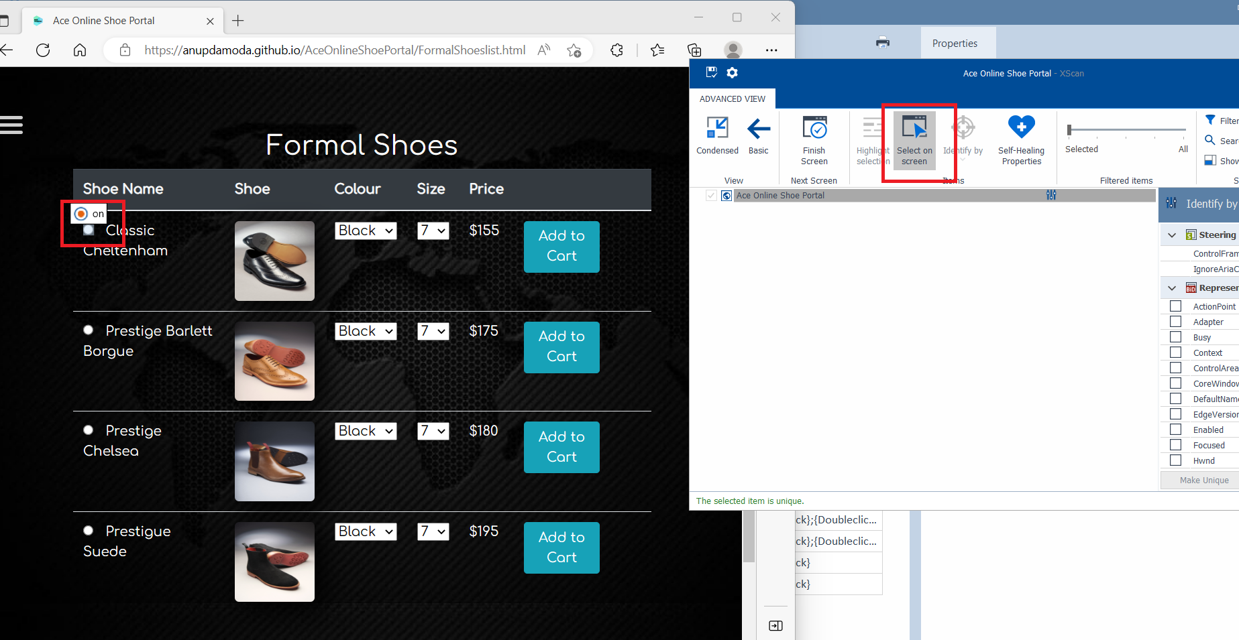
Advanced View Scan - Formal Shoes List
Click on Select on Screen and select the radio button

Slide 18
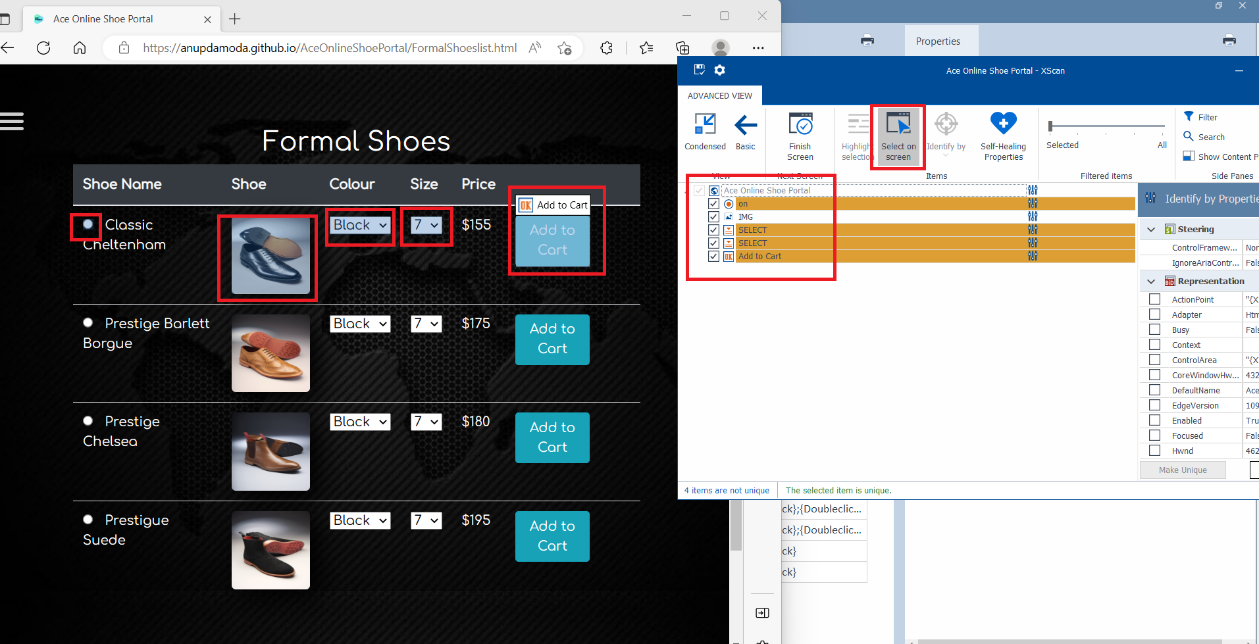
Select all the webelements - Formal Shoes List
Click on the web elements one by one by clicking on “Select on Screen”
None of them are unique

Slide 19
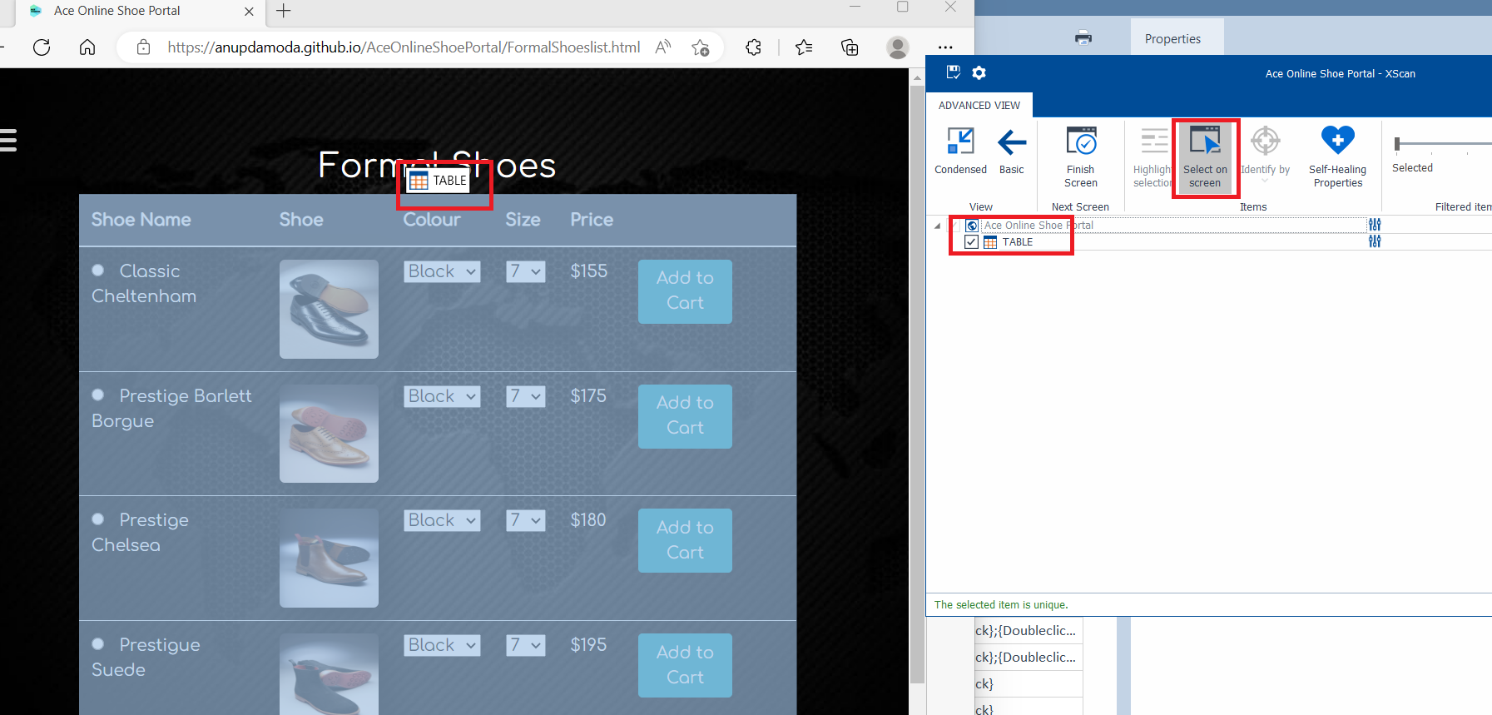
Select the Table - Formal Shoes List
Click on the Table by clicking on “Select on Screen”
Finish and Close

Slide 20
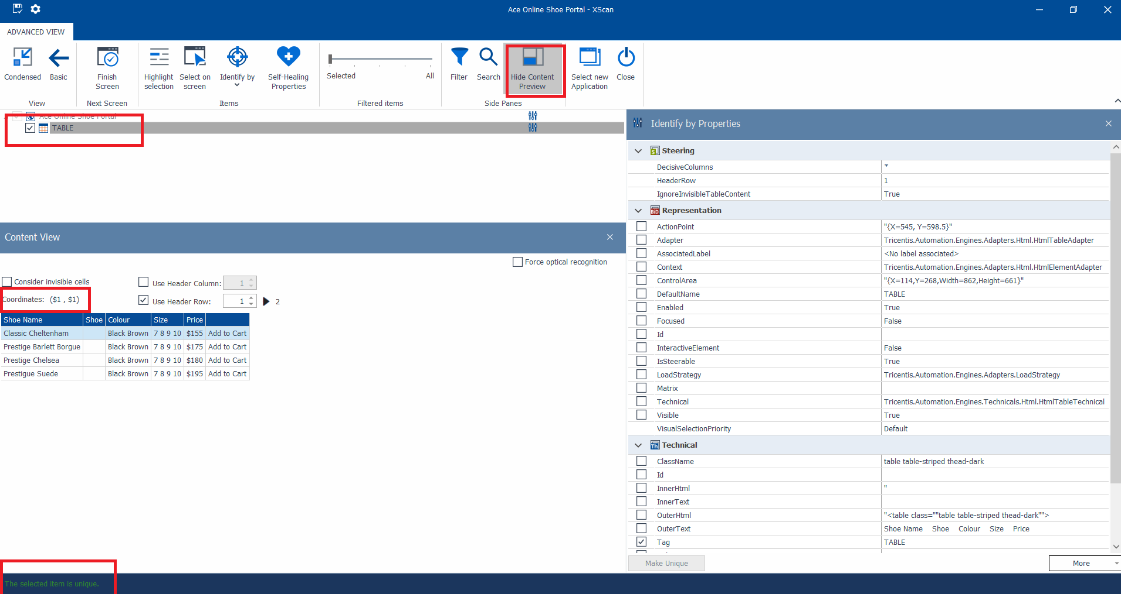
View the Table - Formal Shoes List
Observe the table coordinates.
Finish and Close

Slide 21
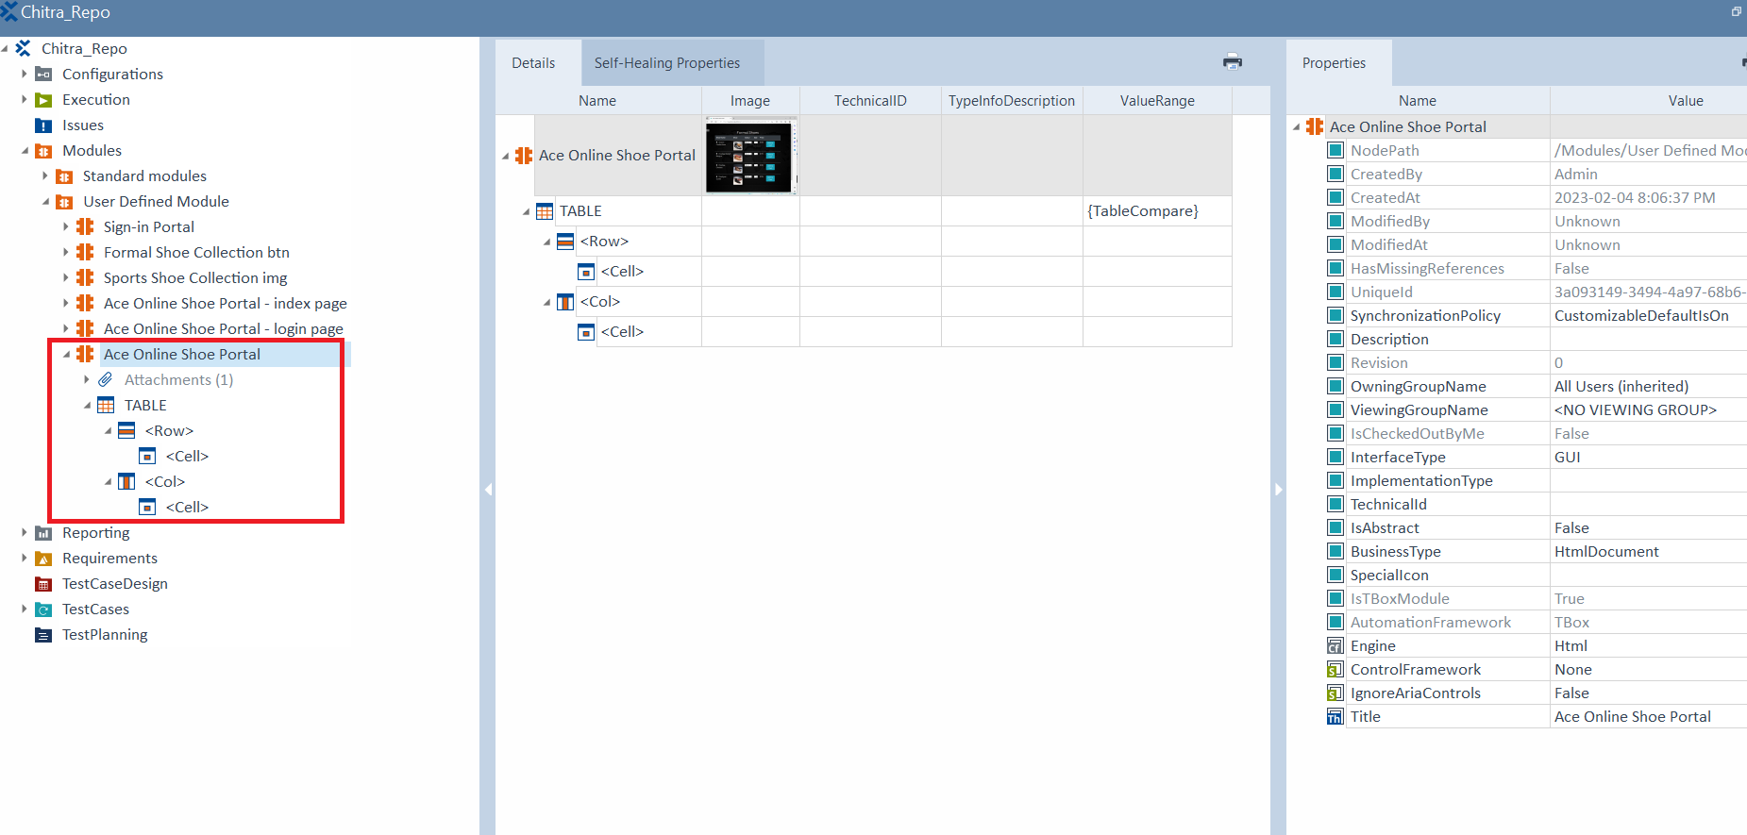
View the new module - Formal Shoes List

Slide 22
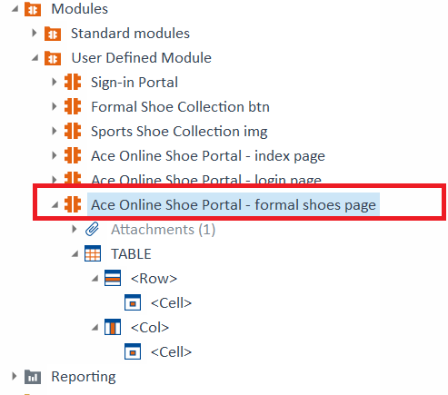
Rename the new Module - Formal Shoes List

Slide 23
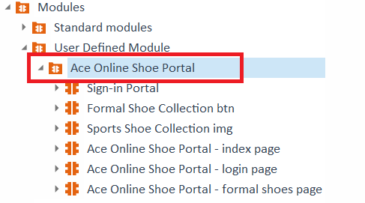
Move the Modules to a Module

